Slide 1

UG Psychology Conference
Drop-in Session
How to present your Final Year Project

Slide 2
UG Psychology Conference
Drop-in Session
How to present your Final Year Project
Why present?
How to make a good oral presentation?
How to make a good poster presentation?
Technical details/deadlines
Q&A

Slide 3

Why present?
Everybody can present! Even without data!
In person or online!
Develop your presentation skills
Add a line on your CV
Win prizes! Love2shop vouchers:
  Best Talk: £50 (1st) & £30 (2nd)
  Best Poster: £50 (1st) & £30 (2nd)
  Price of the public: £50 (talk); £30 (poster)
  Best attendance price: £30

Slide 4
How to make a good oral presentation

Slide 5
Format
Format: 10min including questions
(7-8min for presentation + 2-3min for questions)
Recommendation: 7-8 slides (~1min/slide)
Tips: Short video (3min)

Slide 6
Structuring your presentation
Introduction (1-2 min)
Introduce yourself and the topic
State objectives
Explain importance
Main Content (4-5 min)
Describe methodology
Present results or expected results
Conclusion (1-2 min)
Summarize key findings
Highlight limitations
End with a strong takeaway message

Slide 7

Title Slide
Title of your presentation
Your name
Your supervisor name
Affiliation (Northumbria University)

Slide 8
Introduction (1 min)
Introduce your topic
State the research question
Explain why this topic is important

Slide 9



Engage your audience
Imagine…
Show of hands
Let me tell you a story…

Slide 10
Background & Motivation (1 min)
Provide context for your research
Short summary of relevant literature (references not required)
Define key terms
State your hypotheses

Slide 11
Methodology (2 slides - 2 min)
Describe your research design and methods
Mention key measurements, datasets, or experiments
Keep explanations simple and concise
No superfluous details (e.g., the participant sat on a chair)

Slide 12
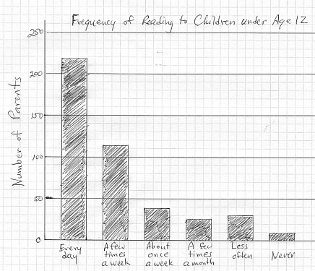
Results (2 slides – 1.5 min)
Present key findings using graphs, tables, or images
Mention statistical tests
You can present expected results!!

Slide 13
Discussion & Conclusion (1.5 min)
Relate findings back to your research question
Discuss limitations & potential future research
End with a takeaway message

Slide 14
Acknowledgments (30 sec)
Thank supervisor, participants and the audience
Provide key references (not mandatory)

Slide 15

Q&A Slide
A simple slide with 'Questions?'

Slide 16
Designing effective slides
Use simple, clean slides
Limit text (6x6 rule)
Use charts, images, diagrams
Readable fonts (24pt+)
Consistent color scheme

Slide 17

Delivery tips
Speak clearly and at a moderate pace
Maintain eye contact
Avoid reading from slides if possible
Use gestures and body language

Slide 18

Handling questions
Listen carefully before answering
Take a pause to think
Keep responses concise
If unsure, acknowledge

Slide 19
Talks Scoring criteria
Is the background clearly discussed?
Did students identify what the rational is for the study?
Did students discuss their aims and hypothesis?
Was enough but not too much detail given to understand what was done (methods)?
Do the results/expected results relate to the aims and hypothesis?
Did students look at the overall picture of their research?
Was the presentation engaging?
Overall presentation of slides (organisation, look...)
The criteria will be scored out of 10 ( 1 being the worst to 10 being perfect)

Slide 20
Technical details
PowerPoint is recommended
Email me your slides (deadline March 3rd):
Jeanne.bovet@northumbria.ac.uk
I will circulate the final programme
Arrive at least 15min before your slot

Slide 21
Final tips
Practice multiple times
Get feedback from peers or mentors
Confidence comes with preparation!

Slide 22
How to create an effective Poster Presentation

Slide 23
Technical details
PowerPoint is recommended
Your poster will be printed as an A1 poster
All posters should be Portrait style
Email me your file (deadline Feb 24th):
Jeanne.bovet@northumbria.ac.uk
I will hang the posters in the morning
Be present during the Poster session! Lunch time 12-1pm

Slide 24
Structuring your Poster
Title & Author/Supervisor: Clearly display title and names
Introduction: Provide context and objectives concisely
Methodology: Outline methods and participants clearly
Results: Use visuals (graphs, tables) to highlight key findings
Conclusion & Future Work: Summarize key takeaways and suggest next steps

Slide 25
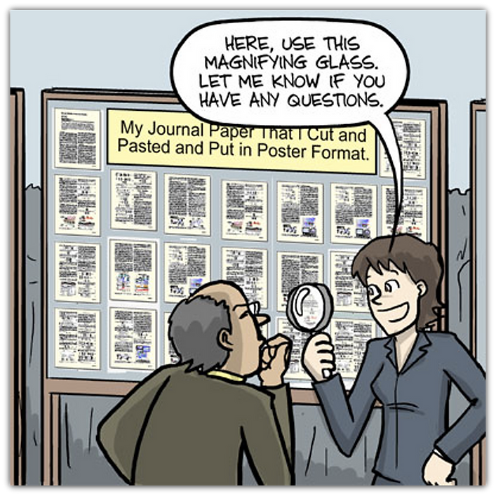
Designing an effective Poster
Keep layout clear and organized (use columns/ sections)
Use minimal text, more visuals (graphs, images)
Choose readable fonts
(minimum 24pt for body text)
Ensure color contrast and
consistency for clarity
Align elements properly

Slide 26

Examples and tips: www.animateyour.science/post/best-examples-of-scientific-posters

Slide 27
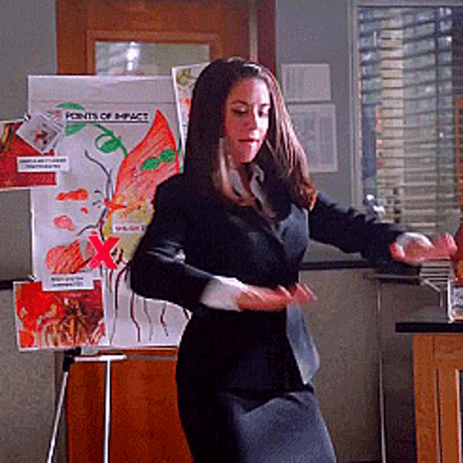
Presenting your Poster
Prepare a brief summary (1-2 min) to introduce your work
Be engaging and approachable
Refer to your poster
to explain key points
Encourage and handle
questions confidently

Slide 28
Poster Scoring criteria
Is the background clearly discussed?
Did students identify what the rational is for the study?
Did students discuss their aims and hypothesis?
Was enough but not too much detail given to understand what was done (methods)?
Do the results/expected results relate to the aims and hypothesis?
Did students look at the overall picture of their research?
Overall presentation of the poster (organisation, look...)?
The criteria will be scored out of 10 ( 1 being the worst to 10 being perfect)

Slide 29
Talk vs Poster
Oral presentations might be more intimidating
Oral presentations are easier to prepare
You can keep your poster
Deadlines: poster need to be sent earlier (Mon Feb 24th vs Mon March 3rd)

Slide 30
Q&A
Conference Website: https://jeannebovet2.wixsite.com/nuucp2025

